Slide 1
Capstone Engagement
Assessment, Analysis, and Hardening of a Vulnerable System
Shaun Poseley

Slide 2
Table of Contents
This document contains the following sections:
01
Network Topology
02
Red Team: Security Assessment
03
Blue Team: Log Analysis and Attack Characterization
Hardening: Proposed Alarms and Mitigation Strategies
04

Slide 3
Network Topology
‹#›

Slide 4
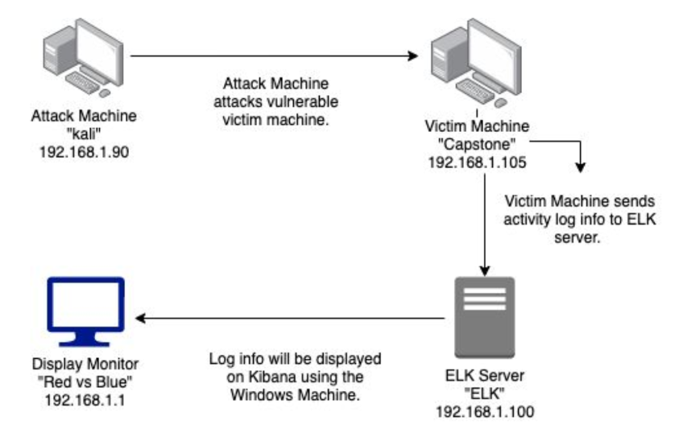
Network Topology
Network
Address Range: 192.168.1.0/24
Netmask: 255.255.255.0
Gateway: 192.168.1.1
Machines
IPv4: 192.168.1.90
OS: Linux 2.6.32
Hostname: Kali
IPv4: 192.168.1.105
OS: Linux
Hostname: Capstone
IPv4: 192.168.0.100
OS: Linux
Hostname: ELK
IPv4: 192.168.1.1
OS: Windows
Hostname: Red vs Blue

Slide 5

Red Team
Security Assessment
‹#›

Slide 6
Recon: Describing the Target
Nmap identified the following hosts on the network:
Hostname | IP Address | Role on Network
Red vs Blue | 192.168.1.1 | Virtual Host Machine
Kali | 192.168.1.90 | Attacking Machine
ELK | 192.168.1.100 | Logs data of activity from the Capstone Machine
Capstone | 192.168.1.105 | Vulnerable Machine

Slide 7
Vulnerability Assessment
The assessment uncovered the following critical vulnerabilities in the target:
Vulnerability | Description | Impact
Port 80 Open | Open ports create the possibility of attackers gaining access to private information and it increases the risk of a data breach. | This vulnerability allowed the attacker to find a private directory containing sensitive information that they would later exploit.
Accessible Files | Web servers, FTP servers, and similar servers may store a set of files underneath a “root” directory that is accessible to the server’s users. | This vulnerability allows attackers to find and obtain files and directory information by connecting to the server over port 80.
Brute Force Attacks | When a password is not complex, it may be vulnerable to a brute force attack where a computer, using a wordlist, will continuously guess the password until it find the correct one. | This vulnerability allowed the attacker to correctly guess Ashton’s password since it wasn’t complex, allowing the attacker access to the secret files on the server.
Hashed Password | Hashed passwords are easily cracked by different tools, such as, John the Ripper, hashcat, and several other online tools. If your hashed password is not salted it may only take minutes for these tools to crack. | This vulnerability allowed the attacker to quickly crack the hashed password found for John, gaining even more access to the server.

Slide 8
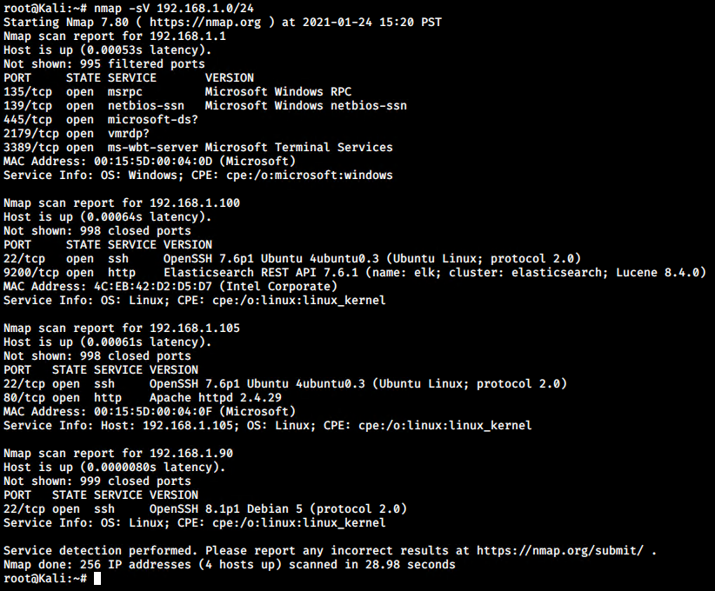
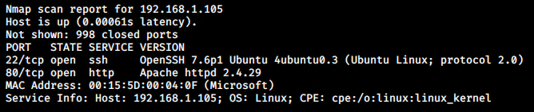
Exploitation: Port 80 Open
Tools & Processes
Using nmap we were able to scan the entire network for any open ports and services.
The command used is as follows:
nmap -sV 192.168.1.0/24
Below is the specific part of the scan report we are paying attention to for this vulnerability.
Achievements
We were able to see that the IP address ‘192.168.1.105’ had port 80 opened, because of this we knew that we may be able to gain access to a directory with important information.

Slide 9
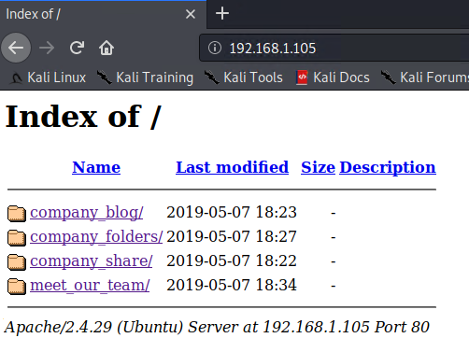
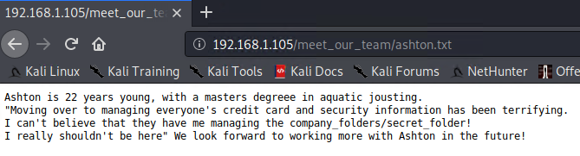
Exploitation: Accessible Files
01
02
Tools & Processes
Now that we know that port 80 was open on the web server, we have opened our web browser and navigated to the server using port 80 to see if there is anything we can view.
Achievements
We were able to successfully gain access to the files. Here we found a list of users, including Ashton. Ashton’s file revealed where a secret folder location may be hidden.

Slide 10
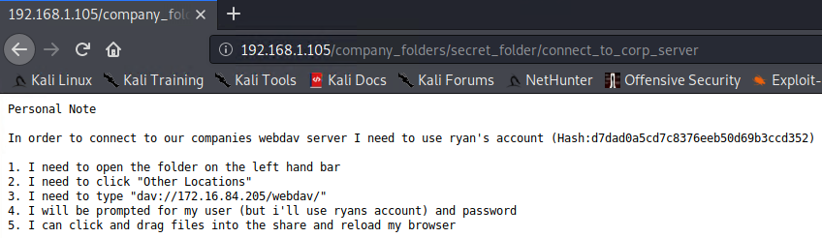
Exploitation: Brute Force Attacks
01
Tools & Processes
Here we were able to use a tool called Hydra in order to brute force Ashton’s password using the username - ashton
02
Achievements
Using this exploit we were able to obtain Ashton’s password, which allowed us to open the secret folder and reveal its contents.

Slide 11
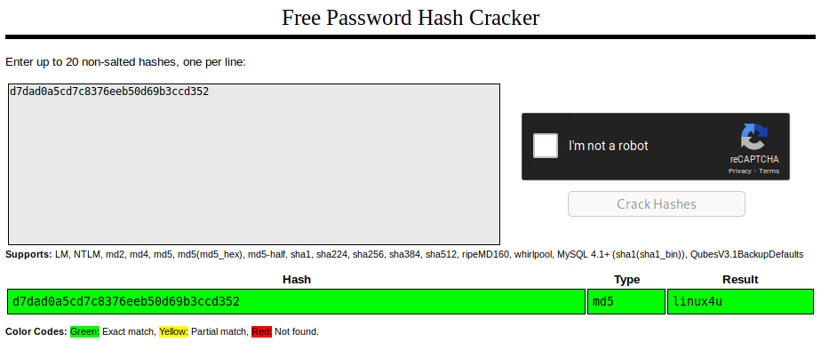
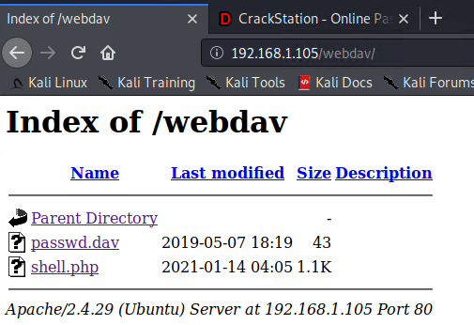
Exploitation: Hashed Password
01
Tools & Processes
Now that we have Ryan’s password hash, we need to use a hash cracker to reveal the plain text version.
02
Achievements
We were able to successfully crack Ryan’s hashed password which gave us access to the WebDav credentials.

Slide 12

Blue Team
Log Analysis and Attack Characterization
‹#›

Slide 13

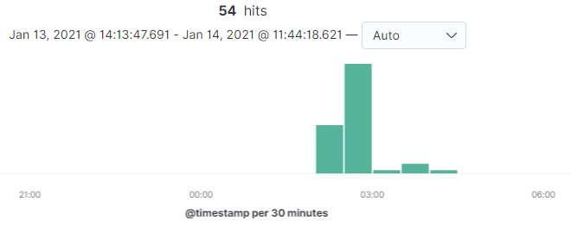
Analysis: Identifying the Port Scan
The port scan began at around 02:00am and lasted until around 04:00am
54 packets were sent from 192.168.1.90
The nmap ping scan sends requests to the 443 port, after filtering for the IP address and port we get the results below.

Slide 14
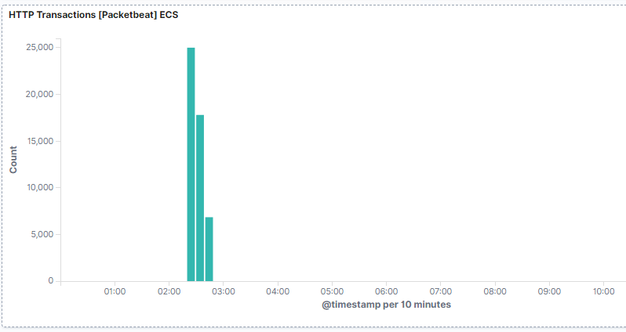
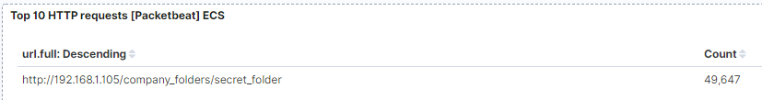
Analysis: Finding the Request for the Hidden Directory
The hidden directory had 49,647 requests ranging from around 01:30am to 02:40am.
The file being requested was called ‘secret_folder’ which was stored within the ‘company_folders’ directory
This secret folder contained instructions on how to on how to connect to the WebDav server using Ryan’s credentials. The password for Ryan was in an MD5 hashed form.

Slide 15
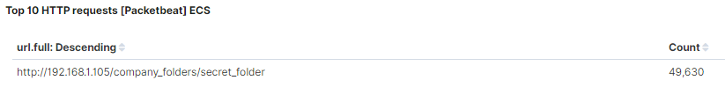
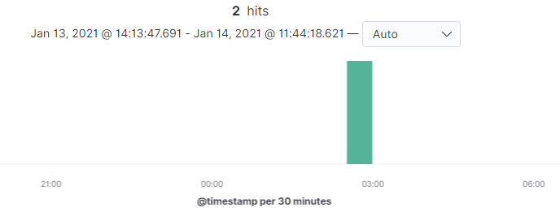
Analysis: Uncovering the Brute Force Attack
There were 49,630 requests made in the brute force attack.
After 49,630 requests from the brute force attack, there were 2 successful in discovering the password.

Slide 16
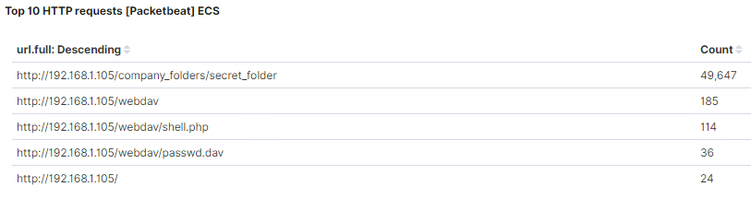
Analysis: Finding the WebDAV Connection
There were a total of 185 requests for the WebDAV directory.
There were two files requests within the WebDAV directory, shell.php and password.dav

Slide 17
Blue Team
Proposed Alarms and Mitigation Strategies
‹#›

Slide 18
Mitigation: Blocking the Port Scan
We will set up an alarm for when a firewall detects more than 15 port scans in a minute.
Most firewalls and Internet Server Providers can detect port scans and cut it off in real time.
Block all ports by default and only enable the ports and traffic you need.
This rule will apply for all standard and complex ports, including TCP, HTTP, and ICMP for ping requests.

Slide 19
Mitigation: Finding the Request for the Hidden Directory
This alarm will be set to go off for any attempted access to this directory or file.
The threshold will be set for more than 1 attempt.
Remove the directory and file from the server. If the file cannot be removed, we will move it to a safer and/or offline location.
In order to remove or move the file to another location, you can run the following commands. Remove directory: rm -r ../company_files
Move directory: mv ../company_files {new location}

Slide 20
Mitigation: Preventing Brute Force Attacks
This alarm will go off after 10 ‘unauthorized’ (401) codes are returned to the server.
We will make a secondary alarm that will looks for the value ‘Hydra’ inside of the ‘user_agent.original’ field.
After a total of 10 ‘unauthorized’ codes are returned to the server, the server could automatically block all traffic from the IP address sending the codes for 1-2 hours.
We could also display a lockout message and lock the page from the login for a temporary period of time from the specific period of time.

Slide 21
Mitigation: Detecting the WebDAV Connection
This alarm will go off anytime this directory is accessed by a machine other than the machine that should have access.
The threshold will be any attempts more than 1.
Connections to this shared folder should not be accessible from the web interface.
Connections to this shared folder could be restricted by machine with a firewall rule.

Slide 22
Mitigation: Identifying Reverse Shell Uploads
We will set an alert for any traffic moving through port ‘4444’.
We will set a secondary alert for any ‘.php’ file that is uploaded to a server.
The threshold will be more than 1 attempt.
The best way to remove this vulnerability is to completely restrict and remove the ability to upload files to this directory over the web interface.

